Slide 1
R vs Python vs SAS Oliver Frost
Tuesday 28 February 2017

Slide 2
Today’s session
A (very quick) introduction to business intelligence and the big data industry.
The role of the analyst.
What is R? What is Python? What is SAS?
Why should I learn them?
What can I use them for?

Slide 3


Oliver Frost GitHub: https://github.com/olfrost Twitter: @OFrost LinkedIn: https://uk.linkedin.com/in/olliefrost
Consolidata Ltd
Twitter: @ConsolidataLtd http://www.consolidata.co.uk

Slide 4

Background
Cognitive Neuroscience BSc
Multiple disciplines – biology, chemistry, psychology, sociology:
Designing experiments
Data collection and research methods
Testing for significance, power calculations, predictive modelling
Data protection, data ethics

Slide 5

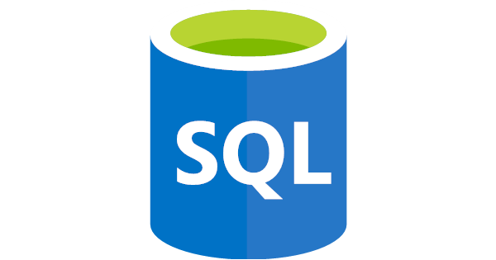
Background
Now working as a data engineer:
Cleaning, reshaping and normalising survey data for a market research company
Developing the Consolidata Data Platform
Active member of the data analytics community

Slide 6
Working as an analyst
You may be familiar with some tools already, depending where you’ve come from:
Excel and Office tools
SPSS, MATLAB
SQL
BI and analytics are a bit of a continuous process:
Cleaning data – missing values? Bad data?
Reshape data – is the data in the right format?
Loading – how much is there?
Find patterns – do these patterns add value?
Presentation – can you tell a story?

Slide 7
Tools – R and Python

Slide 8

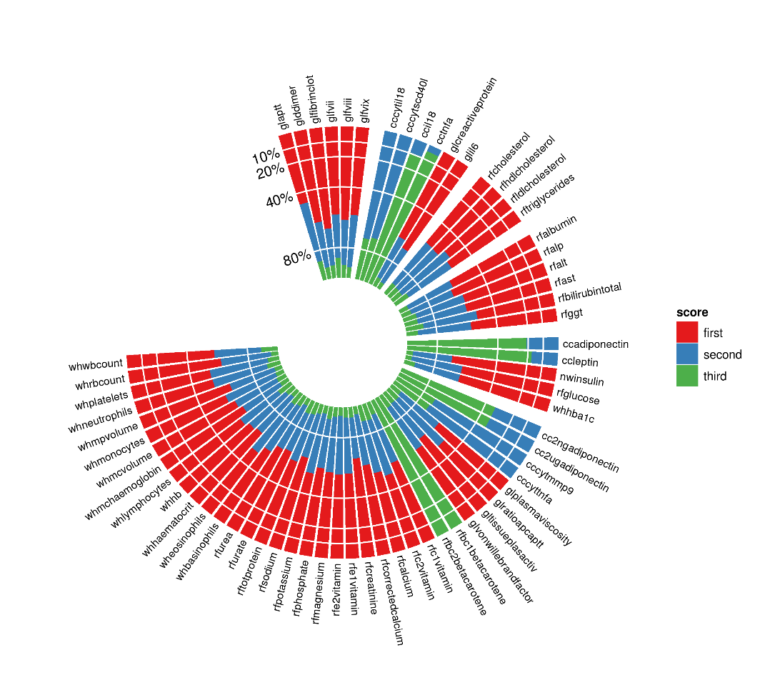
What is R?
R is an open-source programming language, developed by academics and statisticians
Originally for maths and statistical analysis, but is slowly becoming an all-purpose language:
Collect and analyse social media data
Text analytics
Predict trends
Train machines to make predictions
Scrape data from websites
Also a great visualisation tool!

Slide 9

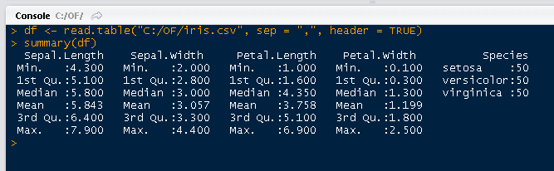
What is R?

Slide 10
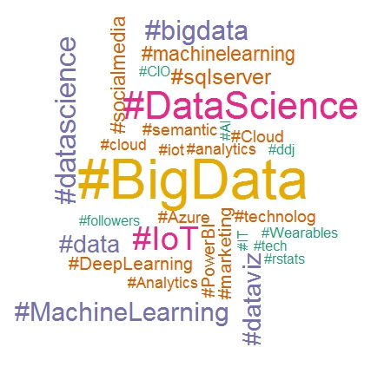
What is R?
It’s easy to learn
It’s free to use
R skills are in demand
The language is becoming increasingly popular
Open-source means you know exactly what your program is doing
Integration with other tools like Excel, SQL Server and pretty much any data analysis tool!
Shorter development cycles because new modules and packages are being released all the time

Slide 11

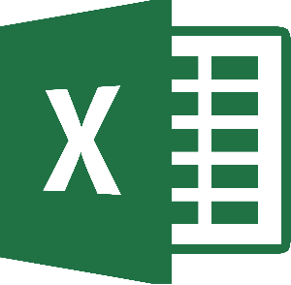




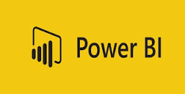

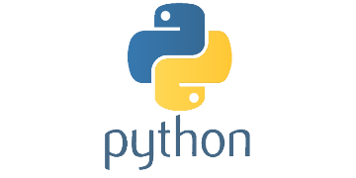


Slide 12
What is Python?
An all-purpose, general language that works on multiple platforms
High level and easy to learn like R
More commonly used for machine learning and predictive modelling (particularly good for academics and data scientists)
Open source and free to learn and use

Slide 13
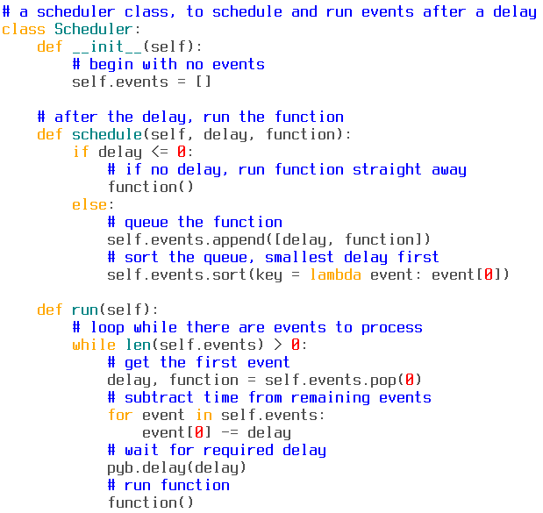
What is Python?
High level means you can write with English-like phrases.
It is fast!
Over 90,000 libraries to choose from when solving a particular problem.

Slide 14
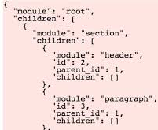
What is Python?
Not just structured data:
Image file analysis (scikit-image)
Read and parse JSON (json)
Audio and music analysis (librosa(?))
More popular than R, so it integrates a bit better with other tools like IBM’s Watson or the Twitter API.

Slide 15
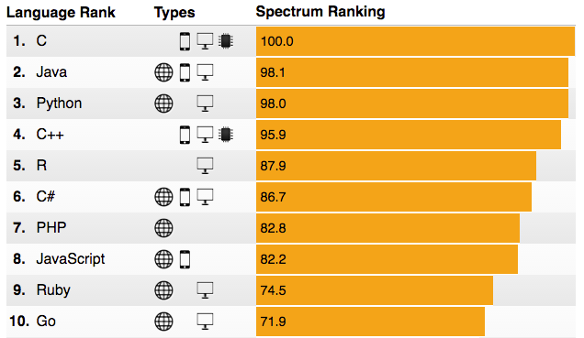
Source: http://spectrum.ieee.org/computing/software/the-2016-top-programming-languages (IEEE - Institute of Electrical and Electronics Engineers)

Slide 16
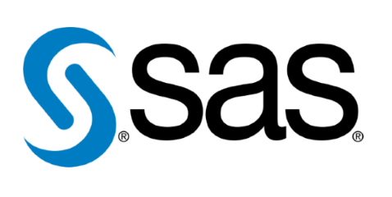
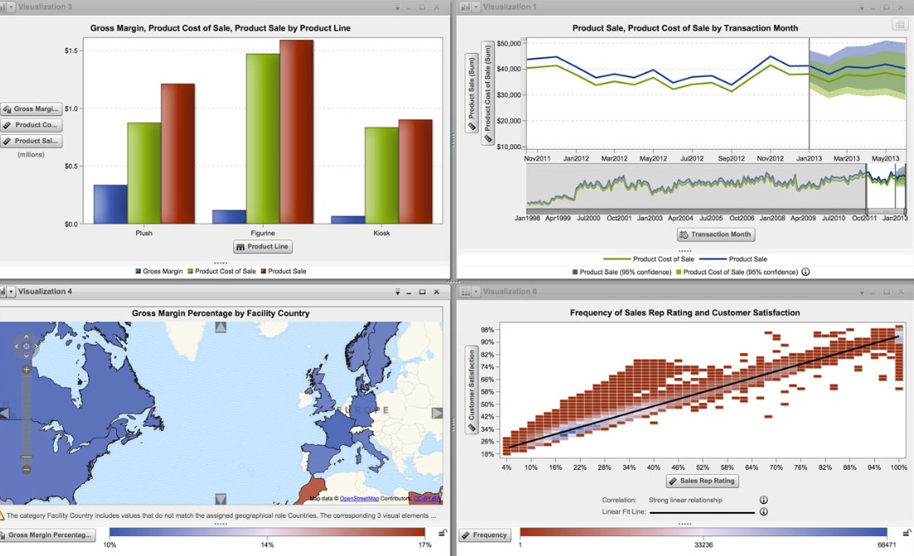
What is SAS?
Statistical Analysis System
Stored data in tables and can be used for:
Writing reports
Developing applications
Data warehousing
Data mining
You don’t have to be technical…
Notes:
perhaps mention in your talk that we are starting to see some SAS to R conversion projects - mainly due to massive cost savings in some cases

Slide 17


R | Python | SAS
Free | Free | Expensive
Data science | Data science, general purpose | Data analysis, data warehousing
Short development cycles | Short development cycles | Longer development cycles
6000+ libraries on CRAN | 95,000+ packages on PyPI | Approx 200 modules

Slide 18

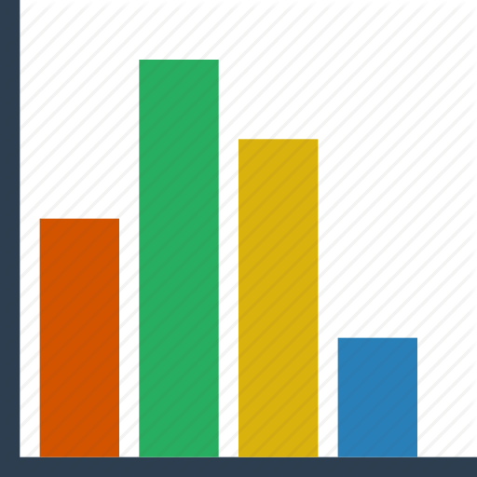


What do businesses use these tools for?
Building “data pipelines”:
New data is coming in all the time.
Needs to be extracted, transformed and loaded.
Needs to be fast.

Slide 19
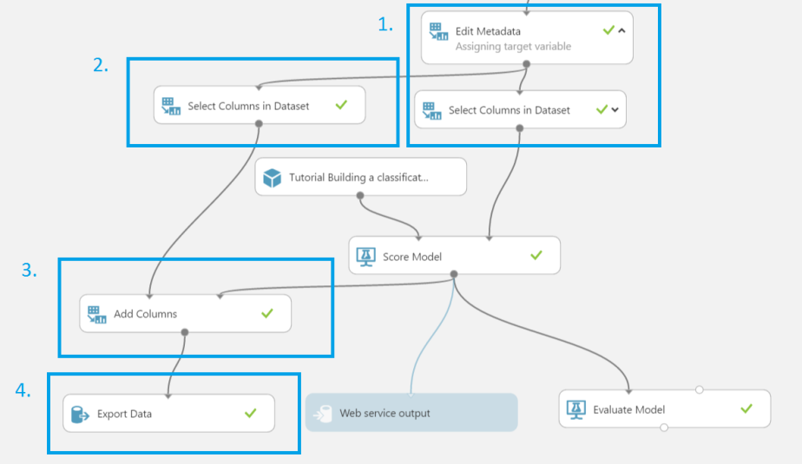
What do businesses use these tools for?
Descriptive Analytics
These skills are in demand.
Businesses want to know about their historical data.
They also want to know what is happening right now.
New marketing opportunities? Save time and money in current processes?
Machine learning and data science?
Can our customers be divided into clusters?
Can we predict what a customer is likely to buy and make recommendations?
Can we detect fraud? Can we predict risk?

Slide 20
Some common questions:
I’m terrible with computers!
I’m terrible at maths!
What’s my earning potential if I learn these skills?

Slide 21
Conclusions
Learning a language can be intimidating, especially from a non-technical background.
But from my experience, it was absolutely worth it.
No need to pick one tool over the other, they are all great.
I would recommend R, though…

Slide 22
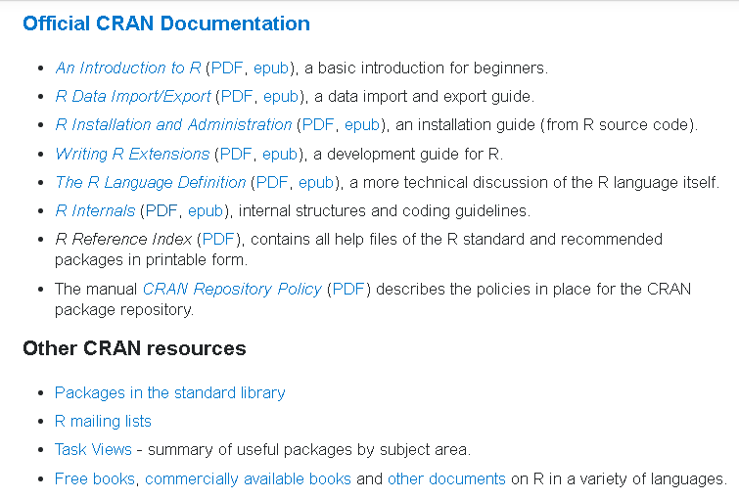
Some resources:
Stack Overflow:
Documentation Topics
Resources, books, tutorials
Consolidata:
R tutorial series
‘swirl’ library in R:
learn R inside R!

